Slide 1
MArketing that workS
David Camp
SVP Business Development

Slide 2
Session Overview
Today’s reality
Focus on where you can win
Market relevance
Automation
Strategies that work

Slide 3
Today’s Reality

Slide 4
Today’s Reality: How You Really Feel!
“My return rate hasn’t been that great with the online presence, so I have gotten more success going through the traditional route where I have been continually farming through post cards for over a decade now. I send out newsletters too, so that is working for me.
But online I’m still scratching it out; I have never had a solid lead on it. So all my stuff has come through referral marketing.”

Slide 5
Today’s Reality: How You Really Feel!
“Post it everywhere, whether I’m setting up direct mail or social media or ads. I post it everywhere.
“It’s really just people that hear about me and then they go and learn about me. Kind of like your resume.”
“I try to blog to create a feel for optimization. I’m not very good at it.”

Slide 6
Today’s Reality: A Clear View

Slide 7
Today’s Reality: What does this mean?
The internet and all of its things has become of form of entertainment;
Getting to the ready, willing and able client online is not easy;
Given these realities, how can a business develop an online marketing solution that works?

Slide 8
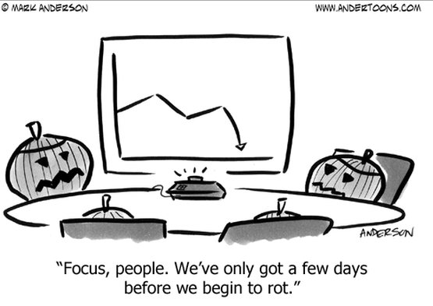
Focus on where you can win!

Slide 9
Focus: Local content and expertise
Local Authority – “Be the subject or market authority”
Search engines constantly modify their algorithms to return results that they believe have the highest relevance to the consumer searching.
Local authoritative position.
Information Integrity
Present information that is updated and relevant.
Deliver content that is meaningful to your audience and call the audience to action!
Consumer Trust
Lack of local authority coupled with information integrity issues can devalue the services you offer.

Slide 10
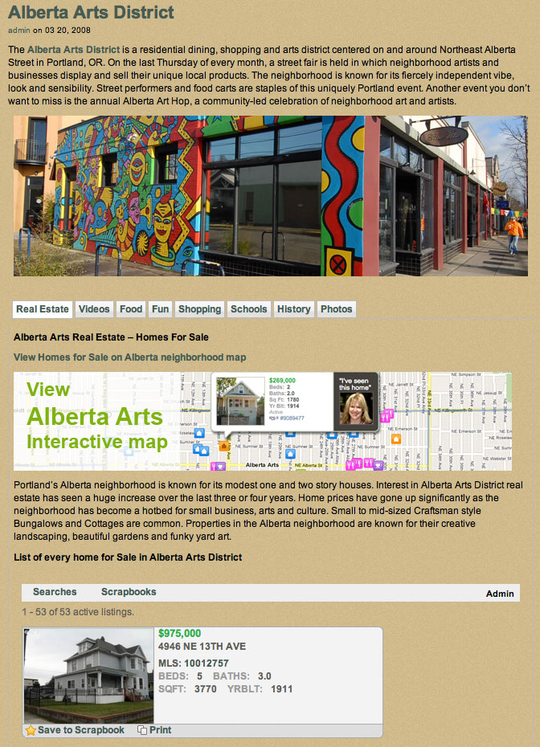
Focus: Local content and expertise
Defines you as relevant
Defines you as the expert
Defines you as a trusted brand
Avoid ‘template’ content
Invest in unique content
Keep it fresh
Promote success

Slide 11
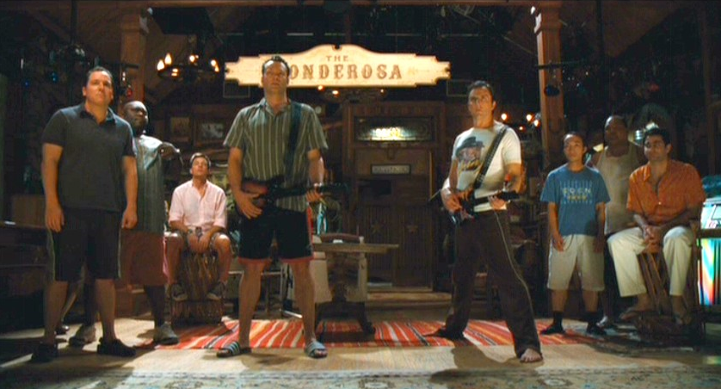
Be Relevant!

Slide 12
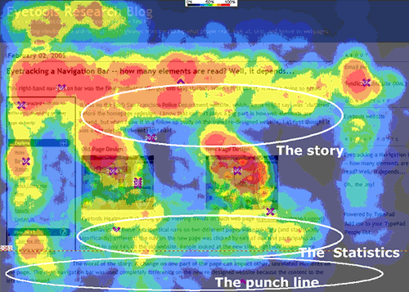
Relevance: What your audience wants?
Eliminate the noise
What matters to consumers?
Can I sale my business?
Business trends
Company values
Other options
Financing
Equity partners
Understand your target audience and build a story that appeals….

Slide 13
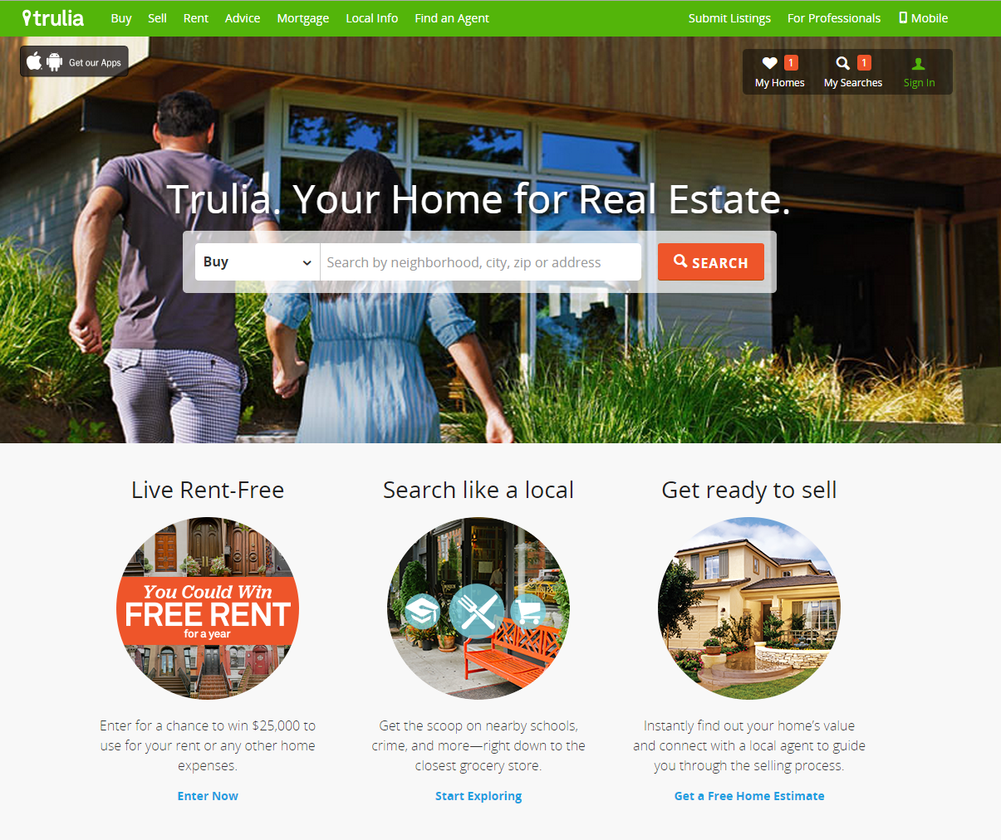
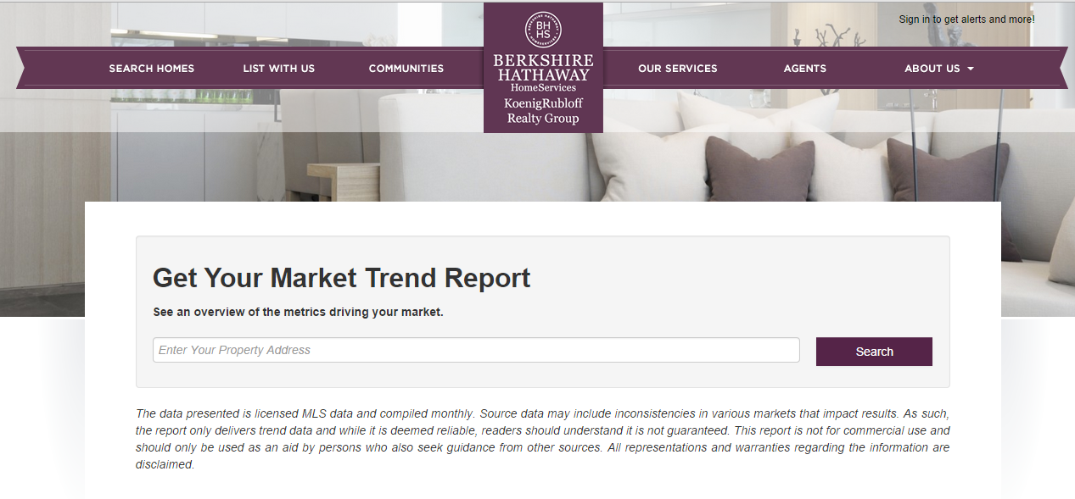
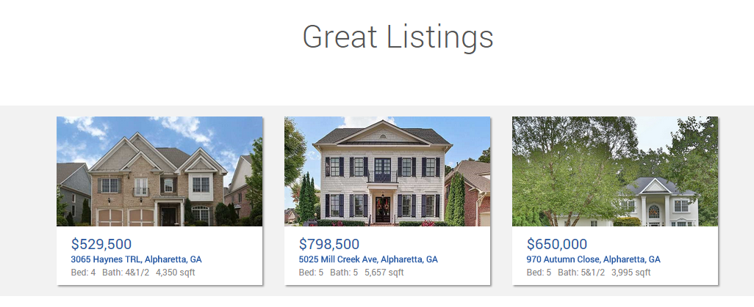
Relevance: What your audience wants?
Presentation improves
Consumer absorption remains

Slide 14
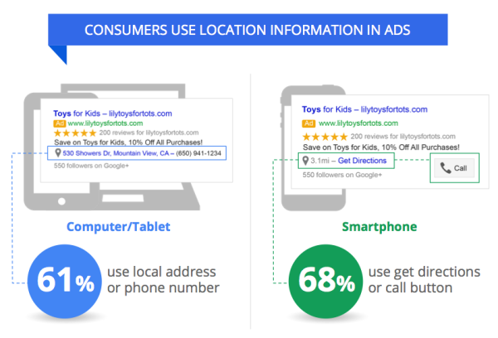
Relevance: What your audience wants?
“Finding your or your service using a mobile device matters…”

Slide 15
Automation of process will drive your ability to scale…
Apply Automation!

Slide 16
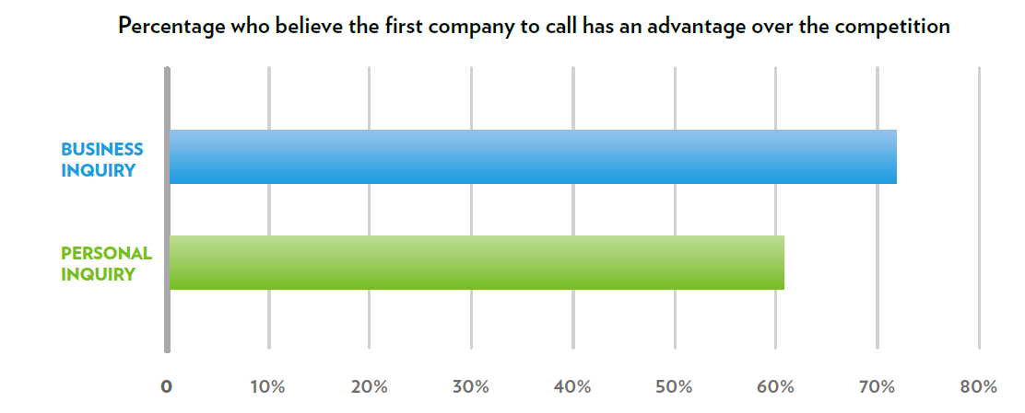
Automation: Content and Responses
The value of timely response driven by automation

Slide 17
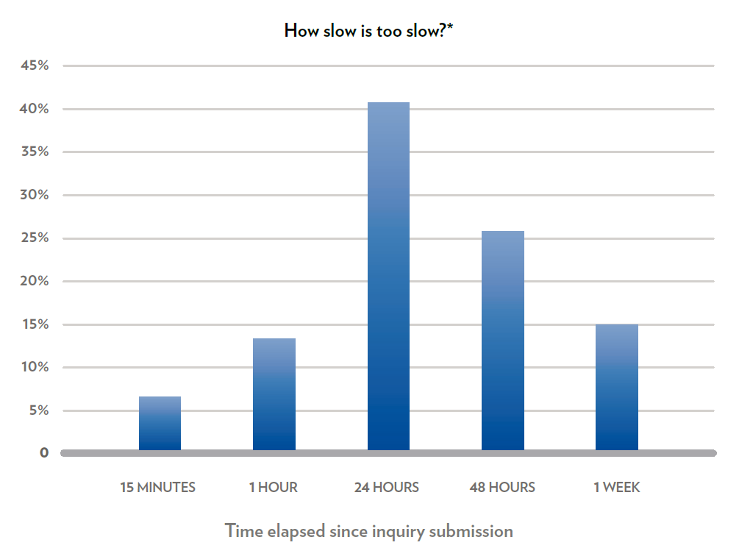
Automation: Content and Responses
How slow is too slow?

Slide 18
Website content strategies that drive leads and expand your sphere of influence…..
Implement Successful Strategies!

Slide 19
Strategies: Lead capture that works
Landing pages
The value proposition
Develop content
Form development
Promotion channels
Measurement

Slide 20
Strategies: Lead capture that works
eBooks
Bring stale content to life
Leverage your local expertise
Exploit real estate strengths
Relocation content
Customer for life content

Slide 21
Strategies: Lead capture that works
Promotions
Giveaways
Build your sphere
Ask the right questions
Identify “now” opportunities
Leverage industry partners

Slide 22
Conclusion

