Slide 1
Signature Bank
Makes it Personal with GABB

Slide 2
Who we are:
Opened our doors in 2005
Headquartered in Sandy Springs
True community bank
22 dedicated employees
$100 Million in Assets
PLP lender with strong emphasis on SBA loans
Offer full array of financial products
Remote Deposit, Online and Mobile Banking
Merchant Services
Cash Management and Payroll Services
Business Credit Cards and more

Slide 3
Mindset we bring to your client:
Our mission begins with Service. It defines who we are and is the standard that drives our success.
WE:
Make It Personal
Aspire To Be The Best
Build Trusting Relationships For A Better Tomorrow
Core Values:
Be Proud Of Your Conduct – It’s Your Signature
Embrace and Drive Continuous Improvement
Make It Personal
Build Lasting Relationships
Service: A Passion Above All Else
Create Wealth Through Profits, Growth And Integrity

Slide 4
Small Bank that can do Big Deals:
Loan Program | Signature Bank Loan | Possible Additional Loan | Estimated 20% Equity (10% buyer / 10% seller note) | Total Project Size including costs & fees
SBA 7a | $5,000,000 | $ 524,000 | $1,381,000 | $6,905,000
SBA 504 | $1,774,000 | $1,419,000 | $ 355,000 (10%) | $3,548,000
Conventional | $1,774,000 | -0- | $ 511,000 | $2,285,000
as of 4/25/2014

Slide 5
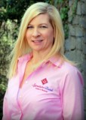
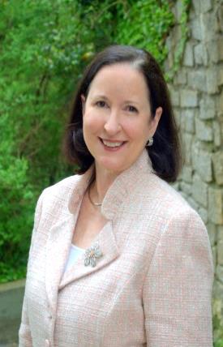
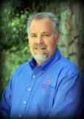
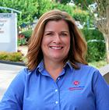
Signature’s Experienced SBA Team:
Melanie Brown
SBA Director
26 years experience
Susan Kite
SBA Lender
26 years experience
Jeff Henley
SBA Underwriter
28 years experience
Lisa McCollum
SBA Client Specialist
20 years experience

Slide 6
We know
What a Business Broker Needs to Know about SBA Loans
To prepare your buyer and seller
To set realistic expectations
To ensure your deal closes as soon as possible

Slide 7
10 Things a Business Broker Needs to Know
1. We can’t process your deal until we have:
Seller Provides:
Buyer Provides:
Last 3 years Business Tax Returns
Signed 4506 T
Recent Interim Business Financial Statement (not > 45 days old)
Aging of Accounts Receivable
Aging of Accounts Payable
List of Assets being sold with Serial Numbers for items valued > $5K
Last 3 years Personal Tax Returns for all 20% or more owners
Last 3 years Business Tax Returns for all affiliate businesses
Personal Financial Statements
Business Plan with Financial Projections
SBA Application Form

Slide 8
What a Broker needs to know – Buyer Cash:
2. Your buyer needs cash in the deal
Amount needed is up to the lender (typically 10% minimum)
25% is required if amount of goodwill financed is over $500K
Can be shared with Seller in form of Standby Note
Equity can be buyer’s cash on hand, a gift supported by a gift letter, personal loan or heloc, or assets other than cash
Equity must be supported by 2 months of statements, or outside appraisal

Slide 9
What a Broker needs to know – Business Plan:
3. Your buyer needs a well thought out Business Plan
Good resource is http://www.sba.gov/category/navigation-structure/starting-managing-business/starting-business/writing-business-plan
Good template is http://imedia.sba.gov/vd/media1/training/2/sbabp/bptemplate.pdf
4. Business Plan must include financial projections
On a monthly basis for the first year, and
On an annual basis for years 1 – 3
Must include Notes as to how the numbers were arrived

Slide 10
What a Broker needs to know – Miscellaneous items:
5. Your buyer must clearly articulate how their background and experience will directly translate into successful ownership of the particular business they are buying.
6. Buyer can not be incarcerated, on probation, parole, under indictment for a felony or a crime of moral turpitude, or who are presently subject to an indictment, criminal information, arraignment, or other means by which formal criminal charges are brought in any jurisdiction.
7. Buyers must be lawfully in the U.S.
8. For loans in excess of $350,000, SBA requires that the lender collateralize the loan to the maximum extent possible up to the loan amount. If fixed assets do not fully secure the loan, the lender must take available equity in the personal real estate of the principals as collateral.

Slide 11
What a Broker needs to know – Seller Note/Goodwill:
9. Seller should be prepared to take back a Note
Generally strengthens the deal
Helps compensate for collateral shortfall
May be needed for equity; if so, SBA counts it as equity if it is a
Standby Note with no payments for the life of the SBA loan
Standby Note with interest-only payments IF the historic business cash flow shows debt service coverage
Standby Note with no payments for the first 2 years IF used as part of the 25% equity required when goodwill is over $500K
10. If the amount of goodwill financed by lender and seller is over $250K, a professional business valuation must be performed.

Slide 12
Want to discuss a deal? Call 770-595-9734
Susan Kite
VP, SBA Business Development Officer
Signature Bank
6065 Roswell Road, Suite 600
Atlanta GA 30328
770-595-9734
Visit us at: www.sbaloansatlanta.com
and: www.signaturebankga.com

