Slide 1
Time Management
November 28, 2017

Slide 2
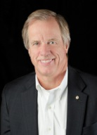
Jeff Lovejoy
Inspire and mentor people to succeed in achieving what they desire

Slide 3
Time Management
Schedule runs person
Reactive
Person runs schedule
Proactive

Slide 4
Time Management
You have the same 86,400 seconds in every day…
Its up to you how you chose to use them

Slide 5
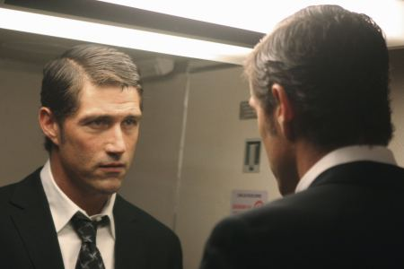
Time Management?
Time Management?
OR
Self Management?

Slide 6
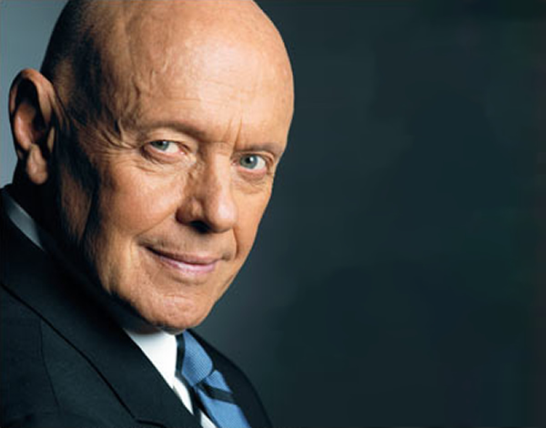
Self Management
“Don’t let what matters least take precedence over what matters most”

Slide 7
Distraction…
“Distraction is draining our focus and productivity” (Darren Hardy, former editor Success Magazine)
Average human attention span in 2016 ?…
8 seconds (Was 12 seconds in 2000)
9 seconds

Slide 8
Distraction…
What’s the most important skill for success in 21 century?
“Learning to control your attention and keep your focus” (Darren Hardy)
Average American:
3.2 hours/day on biz e-mails and 3.4 hrs/day on personal e-mail (Huffington Post)
Adult spends 23 hrs/week texting (USA Today)
4.7 hours/day on social media (Digital Trends)
Most actives between 25 – 54 years old

Slide 9
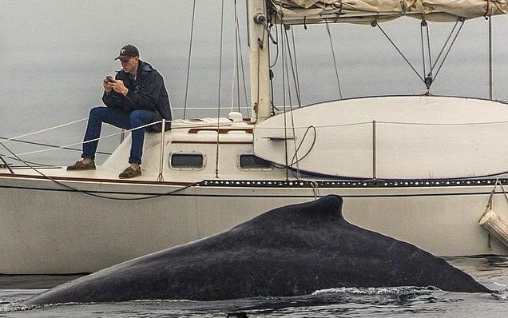
Distraction…

Slide 10
Where Is Your Time Spent?
Notes:
If you believe that time is your most important possession, what do you need to do to better manage how you spend it?
Would it help be better understand how you are spending it today?
Samples in your folders – one by hour and the other by ½ hour

Slide 11
Do You Know…
How many hours per day & week do you work?
What big chunks of activity do you have on most days?
How much time do you spend on each of these “chunks”?
How much of your time do you spend on low priority clients?
What are your top 10 time wasters?
What activities could you delegate or possible outsource?

Slide 12
So What’s the Problem?
“it takes an average of 23 minutes and 15 seconds to get back to the task.”
University of CA – Irvine study
More and more is being expected of us
We have become less productive

Slide 13
What’s the Answer?

Slide 14
5 Elements of Effective Self Management
Value your time
Connect to vision and mission
Review roles
Identify goals
Organize weekly

Slide 15
1. Value Your Time
Where are you spending your time?
S
K
I
L
L
$25 - 50
Per hr
H
$100 -150
Per hr
$ 500+
Per hr
M
$15 - 25
Per hr
$75 - 100
Per hr
$250 -500
Per hr
L
$10 - 15
Per hr
$50 - 75
Per hr
$150 -250
Per hr
Low
Medium
High
V A L U E

Slide 16
1. Value Your Time
“Focusing is about saying ‘NO’” Steve Jobs
People treat your time as you tolerate
Immediate response = expect immediate
You are responding to their agenda, not yours
“It’s not about the time you put it, it’s about what goes into that time.”
90 minute focus on 1 thing – short break – following by another 90 minute total focus

Slide 17
2. Connect to Vision and Mission
The key lies in the clarity of your vision

Slide 18
Do You Know…
What is most important?
What gives your life meaning?
What do you want to be and do in your life?
What vision do you have for your business?
How will you achieve what you want?

Slide 19
2. Connect to Vision & Mission
 | URGENT | NOT URGENT
IMPORTANT | I. (Necessity) Crises Pressing problems Deadline driven Projects, meetings Preparation | II. (Leadership) Preparation Prevention Family Events Planning Relationship Building Recreation
NOT IMPORTANT | III. (Deception) Interruptions Some phone calls Some mail Some reports Some meetings Many popular activities | IV. (Waste) Trivia, Busy Work Junk mail Some phone calls Time wasters “Escape” activities

Slide 20
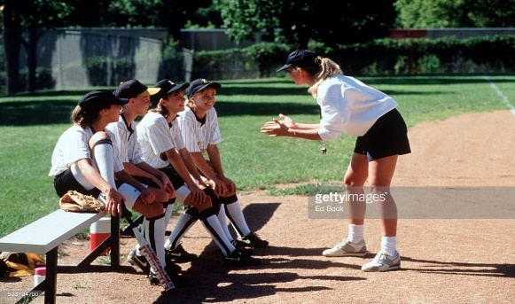
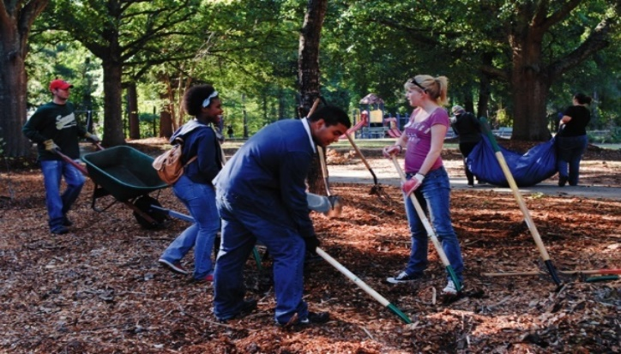
3. Identify Your Roles

Slide 21
4. Establish Goals for Each Role
URGENT
NOT URGENT
I. (Necessity)
II. (Leadership)
Crises
Pressing Problems
Deadline Driven
Prevention
Planning
Team Buildg
Family
Exercise
IMPORTANT
III. (Deception)
IV. (Waste)
NOT
IMPORTANT
Interruptions
Some E-mail
Many Popular Activities
Trivia / Busy Wk
Junk E-mail
Web Surfing
Time Wasters

Slide 22
Solutions – Lack of Direction
Establish a vision for what you want to accomplish
Create 90 day, 1,3 and 5 year goals
You can’t do everything - prioritize
“Don’t let what matters least take precedence over what matters most” Stephen Covey

Slide 23
5. Organize Weekly

Slide 24
Multi-tasking
“Switching between tasks drops IQ by 10%, more than being stoned” CNN
“A man who chases two rabbits catches neither” Confucius

Slide 25
Solutions – Multi-tasking
Do one thing at a time – singular focus
Realize that no one can do it all – prioritize work and focus on one thing
For 1 week focus on doing one thing at a time and notice impact

Slide 26
Conclusion
VALUE your time
Don’t let what matters less take priority over what matters the most – set goals and prioritize your time around goals
Spend less time following other people & more time on LEADING young at a time – singular focus
Become more proactive in scheduling your time – stop being so reactive
Schedule your tomorrow before you leave today – develop a To Achieve list

Slide 27
QUESTIONS
Jeff Lovejoy
Business Strategist
404.444.1836 (cell)
404.250.3221 (office)
Jefflovejoy@actioncoach.com
www.actioncoach.com/jefflovejoy

