Slide 1
The SBDC
Programs, Trends, and Tips
www.georgiasbdc.org
In Partnership with the U.S. Small Business Administration

Slide 3
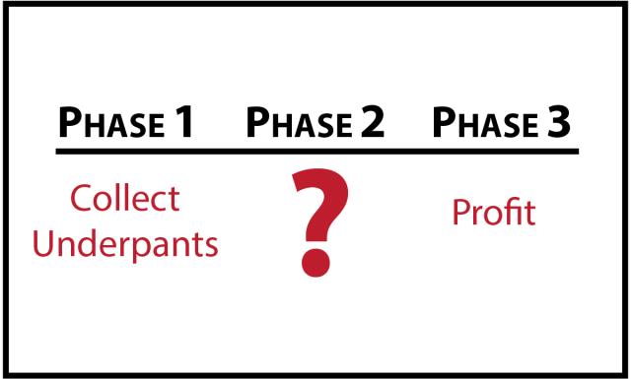
Big Idea

Slide 4
Big Idea

Slide 5
What We Do
Consulting
Classes and Programs
Loan Asssistance

Slide 6
Who We Work With
$0-$5m in sales
Up to 50 employees
GA-based For Profits

Slide 8
Georgia Trends
Nearly 1m business in Georgia
97% of employers
89% of state exports
1.5m employees
41% increase in minority ownership
Hospitality, food, health care, scientific and tech, retail account for 40% of total
Brewing, film, and export potential

Slide 9
Lending Trends
Top performing banks:
Touchmark Bank ($18m)
Metro City Bank ($40m)
First Intercontinental ($20m)
Top industries:
Beer and Liquor ($42m)
Broilers and Other Meat ($29m)
Hotels ($58m)

Slide 11
19 Traction Channels
Viral marketing
PR
Unconventional PR
SEO
SEM
Social and Display Ads
Offline Ads
Content Marketing
Email Marketing
Engineering as Marketing
Targeting Blogs
Biz Dev
Sales
Affiliate Programs
Existing Platforms
Trade Shows
Offline Events
Community Building

Slide 12
SEO
Fat Head, Long Tail
Keywords
Content

Slide 13
Content Marketing
Blogs
Informational Guides
Videos
eBooks

Slide 14
Outlets
Newsletters
Other Blogs
Traditional Media
Blogs/Social Media

Slide 15
Action Items
Brainstorm
Test Tiny
Focus and Consistency
Know Thy Customer

