Slide 1
2016 Social Media strategies that multiply your income
- Dr. Matthew Loop (Georgia Association of Business Brokers only)

Slide 2
“There is no passion to be found in playing small, in settling for a life that is less than the one you are capable of living.”
-- Nelson Mandela

Slide 3



Let’s connect - @MatthewLoop
Instagram
Facebook
Twitter.com

Slide 4
Free blogging Success blueprint
DCincome.com/go/BloggingSuccess

Slide 5
Goal of today

Slide 6
Evolution

Slide 7
Celebrity expert

Slide 8
Systematize

Slide 9
Professional Income

Slide 10

Why should you listen to me?

Slide 11
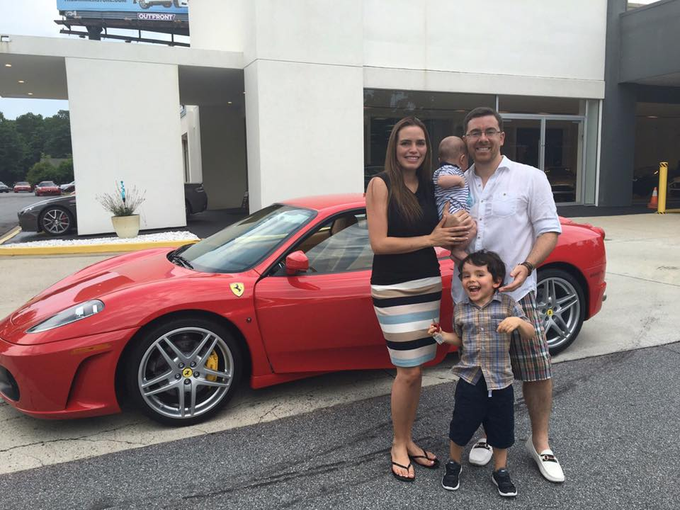

Slide 12
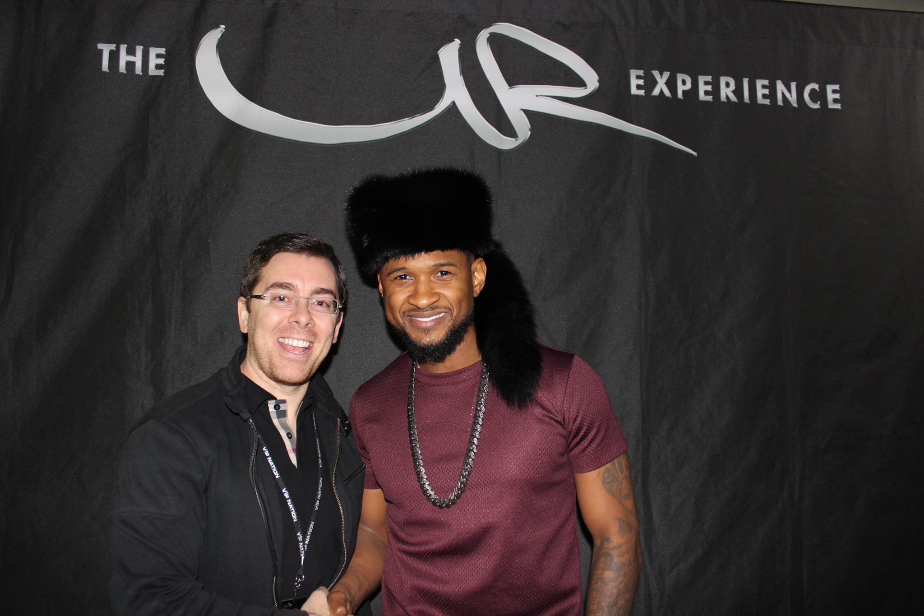

Slide 13
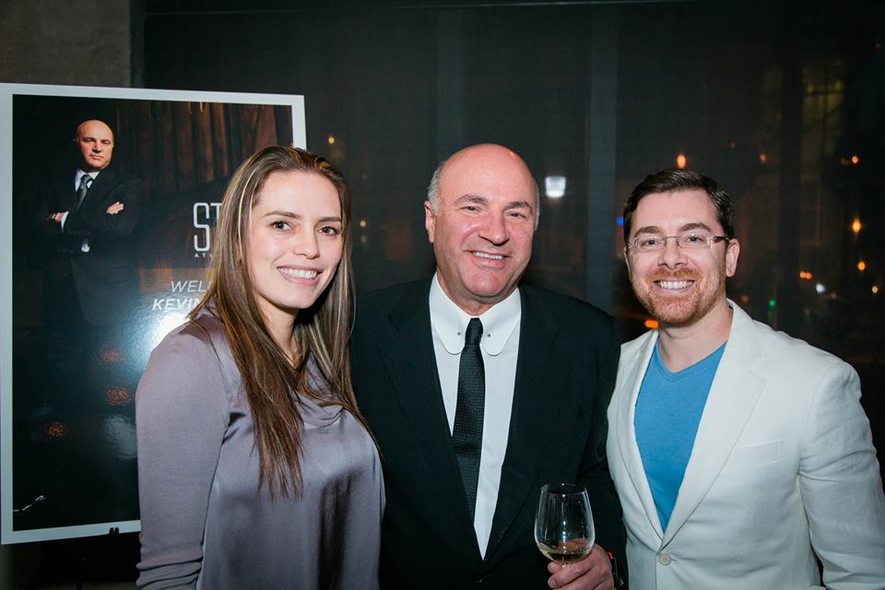

Slide 14
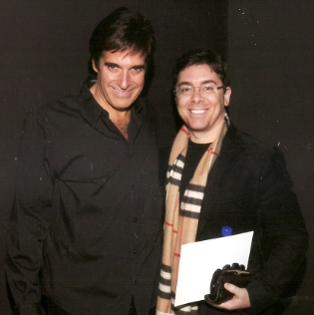

Slide 15
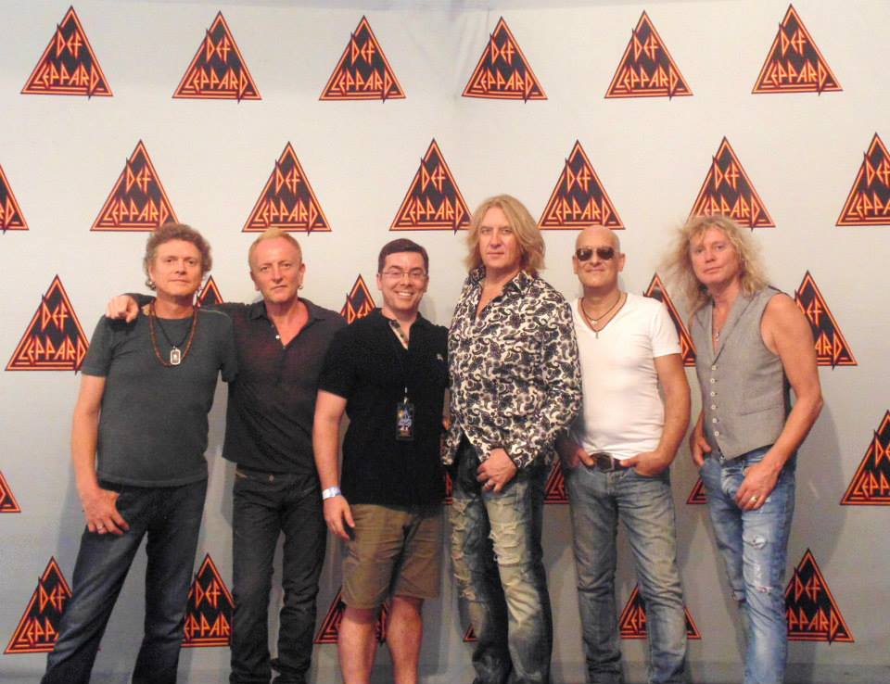

Slide 16
Pillars of Social Media outreach
Reputation / social proof management (Google Maps, Yelp, etc)
Facebook organic
Pay per click advertising (Facebook, Adwords, etc)
Search Engine Optimization (SEO)
Online Video (YouTube) and live streaming apps (Periscope)
Blogging / Microblogging
Photo sharing (Pinterest and Instagram)
Podcasting (iTunes)
News releases and publicity

Slide 17

The social network

Slide 18
Facebook
Over 1.5 BILLION users!
Organic, referral-based - free / earned
(business pages, groups, “likes” “shares” “comments” “check-ins”)
Facebook Advertising - paid
(sponsored ads to the right and in the newsfeed, boosts)

Slide 19
Action Steps to take
Set-up a personal account if you don’t have one. (lol… it’s 2016)
Go to Facebook.com/pages to set-up a “fan page” for your business (Page title is very important) Ex…
Then go to Facebook.com/username to select a vanity URL

Slide 20
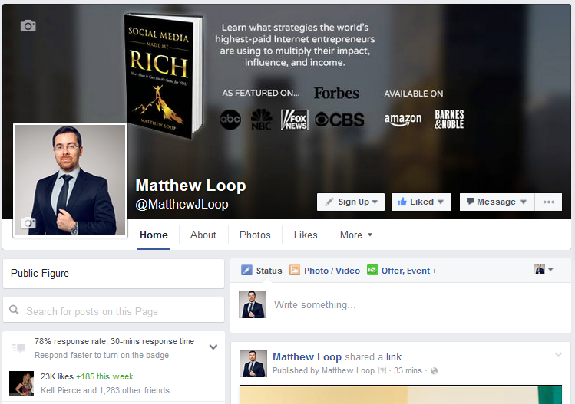

Slide 21
The Importance of Having a Large Quantity of Facebook Fans
Indicator of popularity
Creates trust quickly
More fans = more post views = more website visits
Good for search engine optimization (SEO)

Slide 22
How to get your first 3,000 fans Quickly

Slide 23

Have a laptop or tablet in your Business
Hold a contest to stimulate engagement

Slide 24
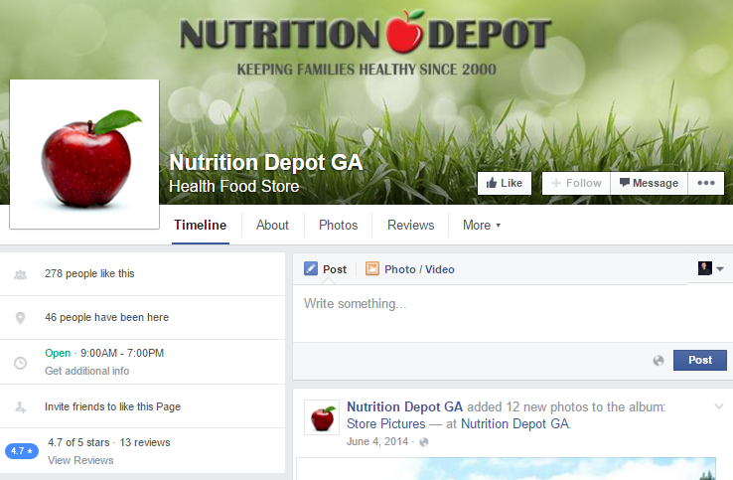
Run Joint venture promos

Slide 25
How to get your first 3,000 fans Quickly
Invite Your Email List and Subscribers
Embed Facebook Fan Page Widgets on Your Website
Add your URL to Your Email Signature Block
Use Facebook as your fan page to like, comment, etc.
Run Facebook Ads to a Your Facebook Page
Run a Contest and Only Members of Your Fan Page can Participate

Slide 26
Cont…
Link to your social media profiles and post
Use Facebook’s check-in feature and incentivize clients to participate
Use Print Media, TV, or radio
Timeline graphic branding

Slide 27
Important action steps
Update your social statuses on Facebook and other social networks at minimum of 4x per day. Post high quality information, quotes of interest, pics, open-ended questions, tips, Facebook videos, blogs, and graphics to build liking and trust.

Slide 28
Beating the news Feed filter
Ask questions → stimulate engagement
Comments are key
Image Caption Contests
Fill in the blank status update
Post more frequently (4 times per day at minimum)
Use Facebook video (live and uploaded)
Review your Insights tab on your Facebook business page

Slide 29
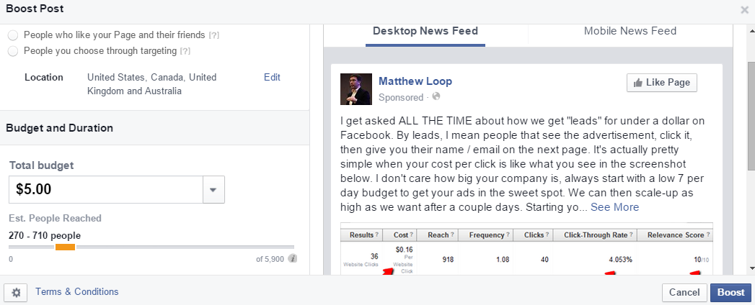
example of a “boosted” post

Slide 30
Facebook advertising
The HOLY GRAIL of Facebook promotion. Unmatched ROI.
I’ve spent over $500,000 on Ads in the last few years and managed over 1 million for clients.
Flip a switch and flood your website with highly targeted traffic
Ads appear in the news feed or on the right column

Slide 31
How I got 1,800 likes to one blog post
Read the article in Social Media Made Me Rich

Slide 32
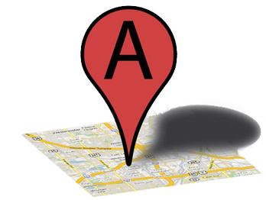
Google My Business

Slide 33
Why Google Maps?
Most valuable real estate
Actually called Google My Business
People buy businesses like they…
… they buy books on Amazon
Trustworthy
Low hanging fruit.

Slide 34
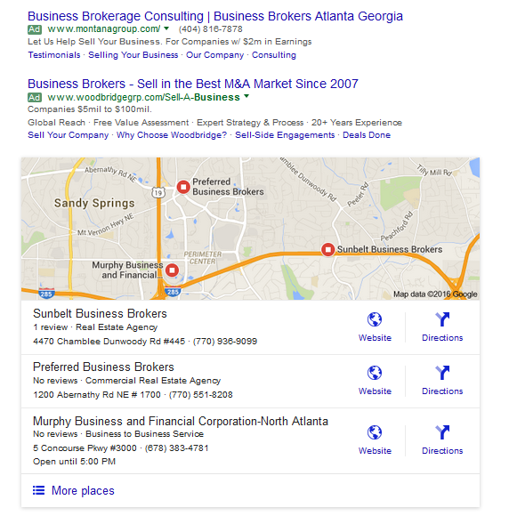
What it looks like
“Business Broker Atlanta”

Slide 35
Do you have a Google Maps listing?

Slide 36
If you have a Maps listing, are you on the 1st page?

Slide 37
Do you have any reviews?

Slide 38
Do you have the most reviews?

Slide 39
Do you have a NEGATIVE review?

Slide 40
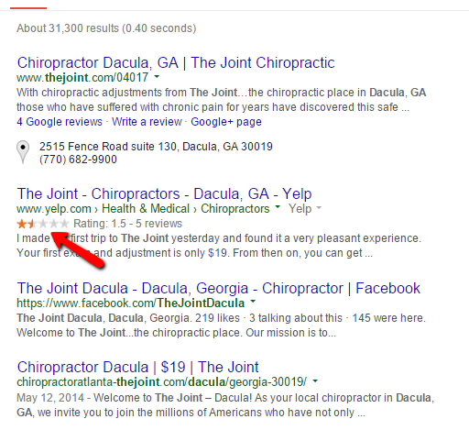
Google Your Name (or Business name)

Slide 41
Where to start
Look for your listing first
Google.com/MyBusiness

Slide 42
Google maps ranking factors
Profile completed
Proper category selected
Keyword in business description
Listing verified
Citations
Reviews
Traffic to your business website
Distance to town center

Slide 43
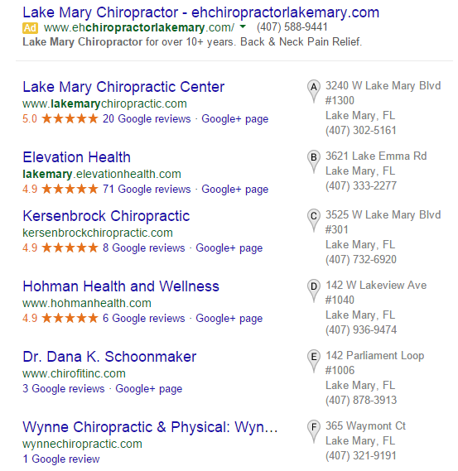

Slide 44
The Script

Slide 45
The money is in the follow-up

Slide 46
Imagine if you implemented this 6 months ago.

Slide 47
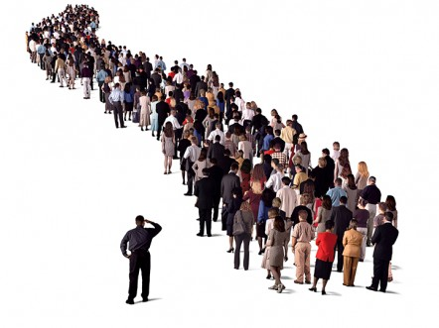
My #1 Social proof rule

Slide 48
Plan of Action

Slide 49
Mistake to Avoid #1
Inconsistency

Slide 50
Mistake to Avoid #2
Not getting started
(It’s 2016!!)

Slide 51
Mistake to Avoid #3
Going at it without professional guidance

Slide 52
Excuse 1
I don’t have the time.

Slide 53
Excuse 2
I’m not a computer geek.

Slide 54
3 Types of Brokers, Attorneys, and Bankers Here

Slide 55
For those in category 2 and 3

Slide 56
Professional guidance and mentorship

Slide 57
I’ve encountered any obstacle and challenge you’ll face with social media.

Slide 58
Introducing “Social Media made me rich”
Best selling paperback – featured on Forbes, ABC, NBC, FOX

Slide 59
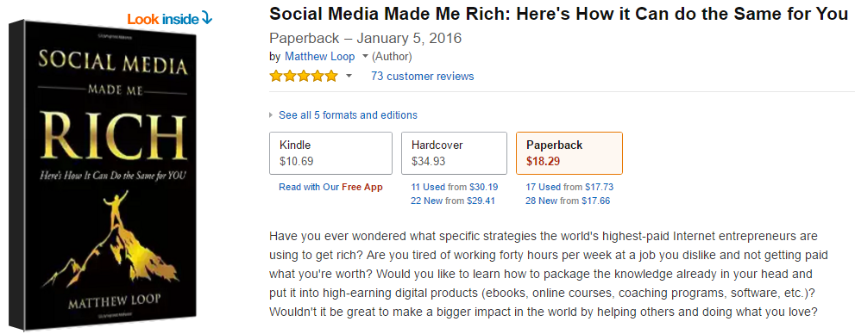
Read what 73 customers had to say

Slide 60
What you get
Facebook organic referral marketing strategies
Facebook advertising strategies
Google+ Local marketing (formerly Google Places/Maps)
Search Engine Optimization (SEO)
Instagram Marketing
Pinterest Marketing for your business
YouTube Video Marketing
Blog Outreach, Distribution, and Marketing
Twitter Marketing for Businesses
Outsourcing and Leveraging
Positioning training and Much more…

Slide 61
What it will do for you
Strategy
Traffic
Top Google rankings
PR
More new leads, clients, and deals
Set of skills

Slide 62
Investment
$29.97

Slide 63
$594 in Free Bonuses (for today)
Quickstart mp3 ($97)
My 7 figure rolodex ($497)

Slide 64
Here’s what to do next
If you like the of attracting more leads and clients each month from Facebook, YouTube, Google, etc… without spending any money on traditional “old school” advertising
Grab a copy of Social Media Made Me Rich today.

Slide 65
Private Coaching and Immersion Days?

