Slide 1
The Business Broker’s Guide to SBA
Susan Kite
Kim Eells
Cheryl Beer

Slide 2
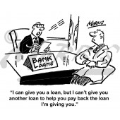
SBA 7(a) loans Program Overview
SBA 7(a) - $5,000,000 maximum loan amount
Small by SBA Size Standards
Operating Company must be “For Profit”
1.15X Debt Service Coverage
“DSC” (including all affiliates)

Slide 3
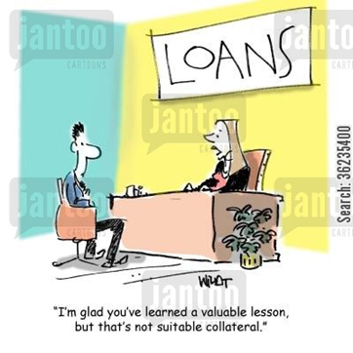
Loan terms
Equity injection: minimum usually 20%, but other factors may affect %
Cash flow
Collateral
Experience
Maximum term
Business only – 10 years
Real estate – 25 years
Business and real estate – weighted avg
Maximum rate
P + 2.75%
Collateral
Business assets
Personal assets of Guarantors

Slide 4
SOP Rules
The buyer must purchase 100% of the ownership interest in the business;
The seller cannot remain an officer, director, stockholder or key employee of the business. If a short transitional period is needed, the small business may contract with the seller as a consultant for a period not to exceed twelve months;
If the purchase price of a business includes intangible assets in excess of $500,000, the borrower and/or seller must provide a combined equity injection of at least 25% of the purchase price of the business. In order for the seller financing to qualify as equity injection, the seller note must be on full standby of principal and interest payments for a minimum of two years. If the total “equity” is greater than 25%, there can be two seller notes. For example, if the buyer has 20% equity and the seller provides 20% seller financing, there can be two seller notes, one for 5% on full standby for two years and one for 15% with immediate P+I payments;
If there is business real estate as part of the change of ownership, the real estate cannot be financed separately by a non-SBA guaranteed loan (unless it is an SBA 504 project) to avoid the 25% cash injection;
5) The lender must obtain a current business valuation from an independent third party chosen by the Bank
to justify the purchase price.

Slide 5
How to get your loans approved quickly
Seller Info
Get Seller Information as quickly as possible after signing listing agreement
Last 3 years tax returns (if sole proprietor, get Schedule C)
YTD interim statement to include Balance Sheet & Income Statement
Previous year’s interim statement of same period
Agings of Accounts Receivable and of Accounts Payable
Listing of all assets being sold – and their market value (with serial numbers for any asset valued at $5,000 or more)
4506-T, properly signed
Letter of Intent or Purchase Agreement
Manage Seller expectations
They will likely have to take a Seller Note of 10% to 15% of sales price
They will need to update Interim Financials and Agings to keep them current (every 60 – 90 days)

Slide 6
Buyer Info
Get Buyer information as soon as possible
Last 3 Years Tax Returns – Personal and Affiliate
Recent Personal Financial Statement – give them form 413
Business Plan (good template is at sba.gov)
Financial Projections (monthly for Year 1 / Annually for Years 1-3)
Manage Buyer expectations
They will have to put in cash equity of 10% to 25% of sales price
They may have to pledge their home or other real estate
They will need to assign us life insurance
If your Buyer has ever been arrested, they need to tell us Early so we can get them cleared and processed
The loan process is not like buying a home – it may take longer than they expect.

Slide 7
Lender Info
Use a lender that knows business acquisition SOP rules
Get with us early and use us as a resource
Realize that to us, DSC is more important than SDI
Have your Seller and/or Buyer prepared
with an organized application package
with realistic expectations about the loan process
The process will be much faster when information is provided quickly when asked

Slide 8
Examples
Example 1:
30 year old niche therapy practice that provides occupational therapy, physical therapy and Speech-Language therapy to school systems.
Buyer has owned a business in home health care.
Total Project Costs of $1,950M included Intangible Assets of $1,600M, Working Capital of $300M, Closing Costs including SBA Guaranty Fee of $50M - Seller Financing of $350M, Buyer’s Cash $100M – SBA Loan $1,500M
Only collateral was a 2nd lien on personal residence.
Example 2:
35-year old Commercial Landscaping company – 3 owners in 60s and retiring. Sales price of $1,605,000 included property, trucks, goodwill. Property valued at $600,000 assets valued at $280,000 with $805,000 goodwill. 2 loans: Building loan at P+2.5% for 25 years and business acquisition at P+2.75% for 10 years with 6-months interest-only for both. Financing structure: $540,000-property, $448,000-business and assets, $136,000-working capital and closing costs, $263,000 – borrower cash, and $360,000 seller note. Buyer was ready to close with out-of-state lender when his partner pulled out, changing deal. We closed 35 days after being notified that the buyer wanted us to consider the deal.
Example 3:
distributor of parts for communications companies that service cell phone towers.
Two husband/wife teams with varied sales and management experience
Total $1,211 included $918 GW, seller 225, equity $269, loan $717, 10 years, P + 2.5, $100 Capline
Collateral included personal assets of Guarantors

Slide 9
Why Loan Applications Get Rejected
Delinquent credit history – 650 minimum score
SBA eligibility issues
912 issues
Presently under indictment, parole or probation
Ever been charged with and or arrested for any criminal offense other than a minor motor vehicle violation? Include offenses which have been dismissed, discharged or not prosecuted
Ever been convicted, placed on pretrial diversion, or placed on any form of probation, including adjudication withheld pending probation for any criminal offense other than a minor vehicle violation?
Not citizen or permanent resident
Problems with Franchisor
SBA failure rate for franchise
Franchisor has reputation for not supporting its franchisees
Talk to other franchisees
Talk to financial institutions who have financed particular franchise

Slide 10
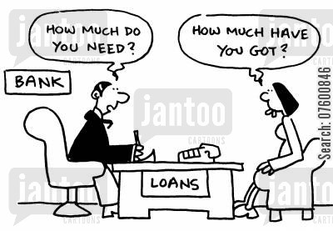
Why Loan Applications Get Rejected part 2
Unrealistic projections
Use financial advisor to prepare business plan and projections
Breakeven analysis
Other issues
Insufficient working capital and equity
Additional support
Spousal income
Strong franchisor support
Strong location
Strong credit history
Liquidity
Management experience
Finally, if you get turned down by a Bank, ask for the reason. The information may help you with another lender or for your next request

Slide 11
Q & A

Slide 12
Contact Information
Susan Kite
404-256-7734
skite@signaturebankga.com
Kim Eells
770-339-2088
keels@thebrandbank.com
Cheryl Beer
678-576-9392
Cheryl.beer@piedmontbankonline.com

